Slide 1
Welcome to T. W. Josey High School

Slide 2
Fun Facts!!!!
My name is Coach Tolbert, I am a 2005 Josey Graduate.
I received My Bachelor’s degree in Psychology from Paine College where I also played basketball.
I have been teaching for 7 years.
I am the Head JV Basketball coach.

Slide 3
My Class Schedule
1st Period U. S History
2nd Period Algebra 1B
3rd Period American Government
4th Period Planning
5th Period 9th Grade Lit
6th period 10th Grade Lit.(Rivera)
7th Period Algebra 1B

Slide 4
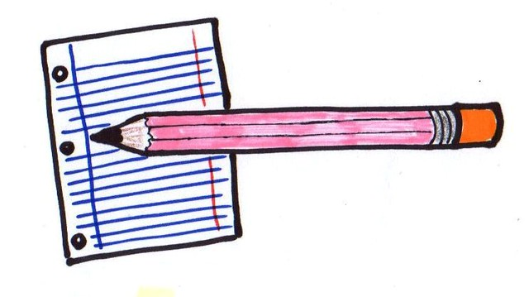
Supplies
Notebook
Pencils/pens
Highlighters
Paper
Index cards

Slide 5
Class Rules
Be on time.
Cellphones must be put up.
Be respectful of peers.
Positive attitudes.
NO PROFANITY!!!!!

Slide 6
Contact Information
Email: Tolbena@Richmond.k12.ga.us
Phone: 762.233.4894

